Slide 1
Classification algorithms

Slide 2
Table of contents
Introduction
What is classification algorithms?
Why classification is important in machine learning ?
Best machine learning algorithms for classification
Types of classification ML
Use cause of classification algorithms
Logistic Regression
Naïve Bayes
K-Nearest Neighbors
Decision Tree
Support Vector Machines
Stochastic gradient descent
Random Forest
The most popular Libraries in machine learning and why we use jupyter notbooks
Conclusion

Slide 3
classification
Introduction
What is classification algorithms?
Why classification is important in machine learning ?
Best machine learning algorithms for classification
Types of classification ML
Use cause of classification algorithms
Logistic Regression
Naïve Bayes
K-Nearest Neighbors
Decision Tree
Support Vector Machines
Stochastic gradient descent
Random Forest
The most popular Libraries in machine learning and why we use jupyter notbooks
Conclusion
Imagine opening your vegetable store to find all your vegetable are mixed up ,making it difficult and time consuming to take what you need .
That’s what classification algorithms in machine learning do.
Classification is one of the critical aspect of supervised learning .
Supervised learning classification in machine learning has use in
face detection
document classification,
handwriting recognition
speech recognition etc.

Slide 4
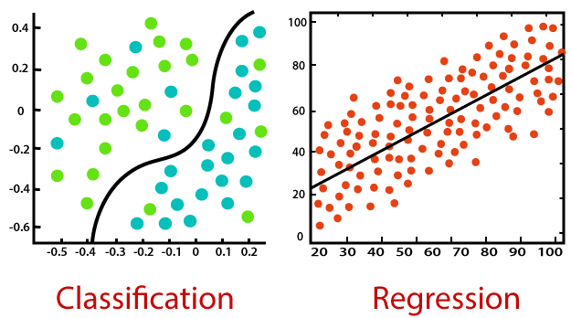
classification
when we talk of supervised ML algorithms, classification and regression are the to most broadly classified ones.
The two main deference b/n them
Classification algorithms predict categorical value .
While regression algorithms predict continuous values.
Introduction
What is classification algorithms?
Why classification is important in machine learning ?
Best machine learning algorithms for classification
Types of classification ML
Use cause of classification algorithms
Logistic Regression
Naïve Bayes
K-Nearest Neighbors
Decision Tree
Support Vector Machines
Stochastic gradient descent
Random Forest
The most popular Libraries in machine learning and why we use jupyter notbooks
Conclusion

Slide 5
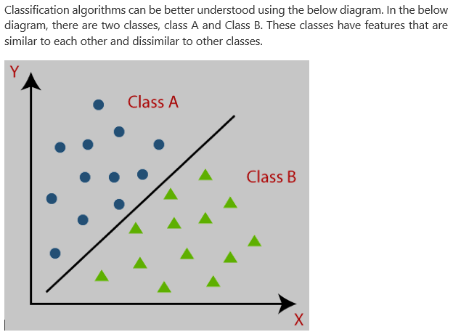
classification
Classification is core to machine learning as it teaches machines how to group data by any particular criteria like predetermine characteristics.
Classification in machine learning is acritical tool today with the rise in the application of big data for making decision across industries .
Introduction
What is classification algorithms?
Why classification is important in machine learning ?
Best machine learning algorithms for classification
Types of classification ML
Use cause of classification algorithms
Logistic Regression
Naïve Bayes
K-Nearest Neighbors
Decision Tree
Support Vector Machines
Stochastic gradient descent
Random Forest
The most popular Libraries in machine learning and why we use jupyter notbooks
Conclusion

Slide 6
classification
There are many machine learning algorithms for classification . Choosing the best classification model more difficult ,and many machine learning practitioners can try multiple classification model to find the best model for their data . However , two very Simple methods get used to determine the best classification model for machine learning /
If our problem is liner , we use logistic regression or a support vector machine (SVM)
How we do know if our problem is liner?
When we plot the problem on graph ,data trace a straight line ,and any changes in an independent variable will always produce a corresponding change in the dependent variable .
If we have a non-liner problem , the best classification model to use for machine learning are
K-Nearest
Naïve Bayes or
Decision tree
Introduction
What is classification algorithms?
Why classification is important in machine learning ?
Best machine learning algorithms for classification
Types of classification ML
Use cause of classification algorithms
Logistic Regression
Naïve Bayes
K-Nearest Neighbors
Decision Tree
Support Vector Machines
Stochastic gradient descent
Random Forest
The most popular Libraries in machine learning and why we use jupyter notbooks
Conclusion

Slide 7
classification
Types of classification ML
Classification algorithms can be further divided into two category
Liner models
Logistic regression
Support vector machine
Non-linear models
K-nearest Neighbours
Kernel SVM
Naïve Bayes
Decision tree classification
Random forest classification
Introduction
What is classification algorithms?
Why classification is important in machine learning ?
Best machine learning algorithms for classification
Types of classification ML
Logistic Regression
Naïve Bayes
K-Nearest Neighbors
Decision Tree
Support Vector Machines
Stochastic gradient descent
Random Forest
The most popular Libraries in machine learning and why we use jupyter notbooks
Conclusion

Slide 8
classification
Classification algorithms can be used in different places. Below are some popular use cases of classification Algorithms
Email Spam Detection
Speech Recognition
Identification of Cancer tumor cells
Drugs Classification
Biometric Identification ,etc.
Introduction
What is classification algorithms?
Why classification is important in machine learning ?
Best machine learning algorithms for classification
Types of classification ML
Use cases of classification algorithms
Logistic Regression
Naïve Bayes
K-Nearest Neighbors
Decision Tree
Support Vector Machines
Stochastic gradient descent
Random Forest
The most popular Libraries in machine learning and why we use jupyter notbooks
Conclusion

Slide 9
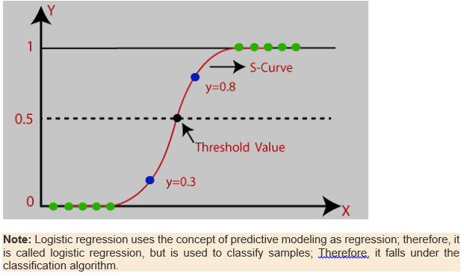
classification
Logistic Regression in machine learning
It is used for predicting the categorical dependent variable using a given set of independent variable.
The outcome must be a categorical or discrete value. It can either yes or no ,0 or 1,true or false, etc. but instead of giving the exact value as 0 and 1 it gives the probabilistic value which lie between 0 and 1.
In logistic regression ,instead fitting a regression line ,we fit an “S” shaped logistic function ,which predict two maximum value (0 or1).
Introduction
What is classification algorithms?
Why classification is important in machine learning ?
Best machine learning algorithms for classification
Types of classification ML
Use cases of classification algorithms
Logistic Regression
Naïve Bayes
K-Nearest Neighbors
Decision Tree
Support Vector Machines
Stochastic gradient descent
Random Forest
The most popular Libraries in machine learning and why we use jupyter notbooks
Conclusion
Logistic function (Sigmoid function)
The sigmoid function is a mathematical function used to map the predicted value to probability
It maps any real value into another value within arrange of 0 and 1.
From sklearn.liner_model import LogisticRegression
Lr = LogisticRedression()
Lr.fit(x_train,y_train)
Y_pred=lr.predict(x_test)

Slide 10
classification
Introduction
What is classification algorithms?
Why classification is important in machine learning ?
Best machine learning algorithms for classification
Types of classification ML
Use cases of classification algorithms
Logistic Regression
Types of logistic Regression :
Naïve Bayes
K-Nearest Neighbors
Decision Tree
Support Vector Machines
Stochastic gradient descent
Random Forest
The most popular Libraries in machine learning and why we use jupyter notbooks
Conclusion
Types of logistic Regression :
on the basis of categories ,logistic regression can be classified into three types
binomial: in binomial logistic regression ,there can be only two possible types of the dependent variables, such as 0 and 1,pass or fail etc.
Multinomial: in multinomial logistic regression there can be three or more possible unordered types of the dependent variables ,such as “cat”, ”dog”, ”sheep” .
Ordinal: in ordinal logistic regression ,there can be 3 or more possible ordered types of dependent variables such as “low”, ”Medium”, or “High”.

Slide 11
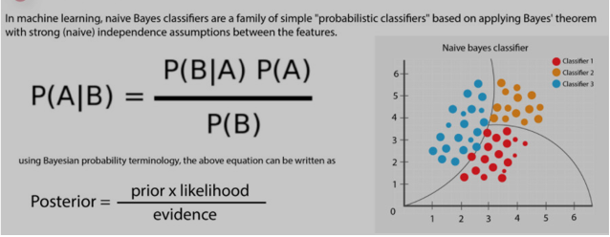
classification
Naïve Bayes
Is a simple classification algorithms that helps build fast machine learning models that can make quick predictions. The algorithms predicts based on the probability of an object and is also known as a probabilistic classifier.
Introduction
What is classification algorithms?
Why classification is important in machine learning ?
Best machine learning algorithms for classification
Types of classification ML
Use cases of classification algorithms
Logistic Regression
Types of logistic Regression :
Naïve Bayes
K-Nearest Neighbors
Decision Tree
Support Vector Machines
Stochastic gradient descent
Random Forest
The most popular Libraries in machine learning and why we use jupyter notbooks
Conclusion
Notes:
ll Probability Formulas List in MathsProbability
Range0 ≤ P(A) ≤ 1
Rule of AdditionP(A∪B) = P(A) + P(B) – P(A∩B)
Rule of Complementary EventsP(A’) + P(A) = 1
Disjoint EventsP(A∩B) = 0
Independent EventsP(A∩B) = P(A) ⋅ P(B)
Conditional ProbabilityP(A | B) = P(A∩B) / P
(B)Bayes Formula P(A | B) = P(B | A) ⋅ P(A) / P(B) means that P(A|B) means the probability that A will occur given that B has occurred.

Slide 12
classification
Introduction
What is classification algorithms?
Why classification is important in machine learning ?
Best machine learning algorithms for classification
Types of classification ML
Use cases of classification algorithms
Logistic Regression
Types of logistic Regression :
Naïve Bayes
K-Nearest Neighbors
Decision Tree
Support Vector Machines
Stochastic gradient descent
Random Forest
The most popular Libraries in machine learning and why we use jupyter notbooks
Conclusion
Benefit of Naïve Bayes algorithms
Naïve Bayes algorithms quickly predicts the class of the test data set. Moreover ,it also performs accurately in a multi-class prediction scenario.
Real world project is spam filtering and sentiment analysis
Gmail from google uses Naïve Bayes algorithms for filtering spam emails.
Sentiment analysis is another area where naïve Bayes can calculate probability of emotions expressed
in the text being positive or Negative .
The advantage of naïve Bayes algorithm requires small amount of training data to estimate the necessary
parameter . This method are Extremely fast compered to more sophisticated methods .
Disadvantage is a bad estimator.
From sklearn.naive_Bayes import GassianNB
Nb=GaussianNB()
Nb.fit(x_train,y_train)
Y_prad=nb.predict(x_test)

Slide 13
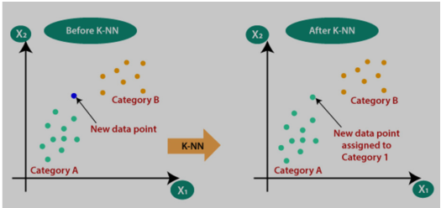
classification
K-Nearest Neighbors
K-nearest neighbors (KNN) algorithm is a data classification method .it estimate the possibility that a data point will become member of any of groups based on what group the data point nearest to it belongs to.
What is classification algorithms?
Introduction
Why classification is important in machine learning ?
Best machine learning algorithms for classification
Types of classification ML
Use cases of classification algorithms
Logistic Regression
Types of logistic Regression :
Naïve Bayes
K-Nearest Neighbors
Decision Tree
Support Vector Machines
Stochastic gradient descent
Random Forest
The most popular Libraries in machine learning and why we use jupyter notbooks
Conclusion
Examples with real-world projects
Finding the ratio of breast cancer : in healthcare , the KNN algorithm is in use
As a classifier to predict breast cancer based on the previous history of age locality,
And other conditions .besides that ,recommendation engines of portals Netflix , Amazon,
You tube ,etc. use them.
From sklearn.neidhbors import KNeighborsClassifier
Knn=KNeighborsClasssifier(n_neighbors=15)
Knn.fit(x_train,y_train)
Y_pred=predict(x_test)

Slide 14
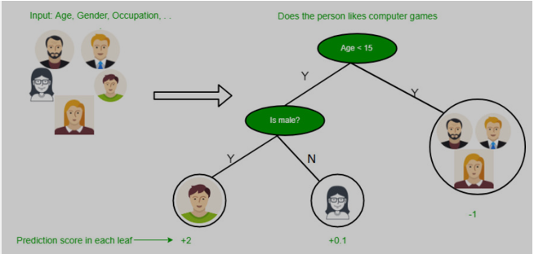
classification
Decision Tree
Decision tree supervised learning technique.
It can work both classification and regression problems but a preference in solving classification problems in a tree structured classifier , the internal node represents the features of dataset , branchs represent the decision rule , and each leaf node represents the outcome.
Introduction
What is classification algorithms?
Why classification is important in machine learning ?
Best machine learning algorithms for classification
Types of classification ML
Use cases of classification algorithms
Logistic Regression
Types of logistic Regression :
Naïve Bayes
K-Nearest Neighbors
Decision Tree
Support Vector Machines
Stochastic gradient descent
Random Forest
The most popular Libraries in machine learning and why we use jupyter notbooks
Conclusion
Notes:
This algorithm are popular in Biomedical Engineering (decision tree for identifying features to be used in implantable devices )
,Financial analysis to know customer satisfaction levels with a product or service , etc.
From sklean.tree import decisionTreeClassifier
dtree = DecisionTreeClassifier(max_depth=10,random_state=101,
Max_features=none,min_samples_leaf=15)
dtree.fit(x_train,y_train)
Y_pred=predict(X_test)

Slide 15
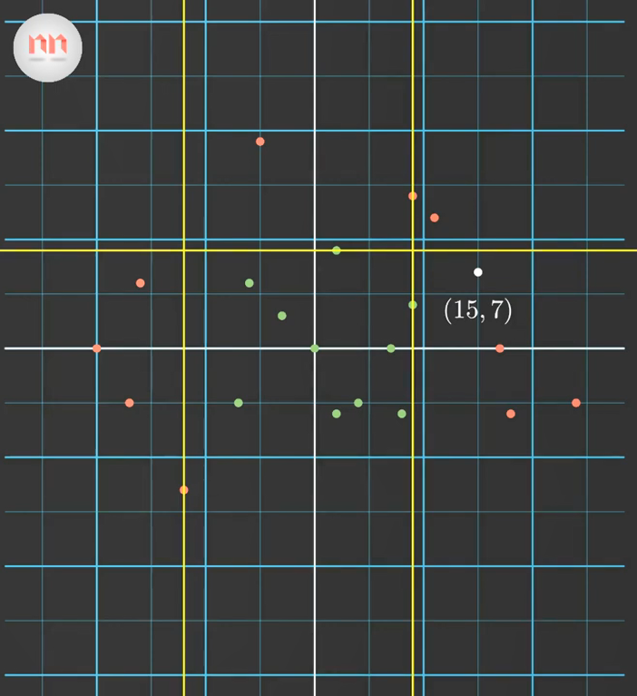
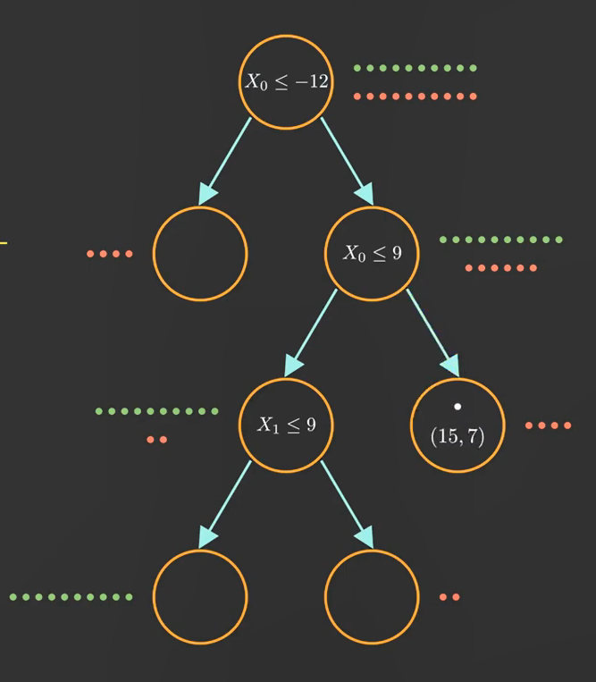
Additional Decision Tree example

Slide 16
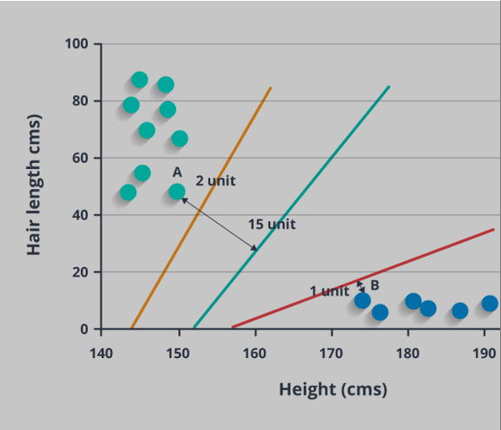
classification
Introduction
What is classification algorithms?
Why classification is important in machine learning ?
Best machine learning algorithms for classification
Types of classification ML
Use cases of classification algorithms
Logistic Regression
Types of logistic Regression :
Naïve Bayes
K-Nearest Neighbors
Decision Tree
Support Vector Machines
Stochastic gradient descent
Random Forest
The most popular Libraries in machine learning and why we use jupyter notbooks
Conclusion
Support Vector Machine(SVM)
Commonly used for classification and regression challenges . however , the preference is for use in classification problems. It is representation of the training data as a point in space separated into categories by clear gap that is as wide as possible.
New example are then mapped into that same space and predicted to belong to a category based on which side of the gap they fall.
Common application of SVM are in application like
Face detaction : predict the identity of agiven face .
Classification of images : svm provides better search accuracy during image classification
Bioinfomatics: it includes protein classification and cancer classification
From sklearn.svm import SVC
svm=SVC(kernel=“linear”,c=0.025,random_state=101)
Svm.fit(X_train,y_train)
Y_pred=sm.predict(X_test)

Slide 17
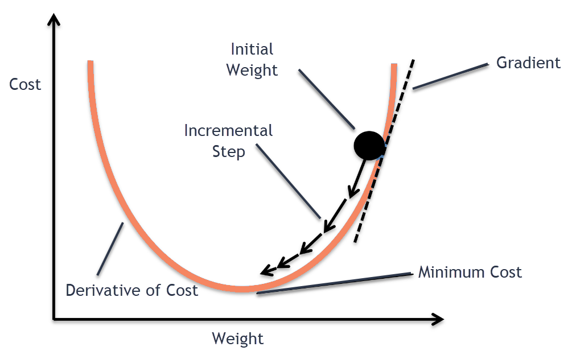
classification
Introduction
What is classification algorithms?
Why classification is important in machine learning ?
Best machine learning algorithms for classification
Types of classification ML
Use cases of classification algorithms
Logistic Regression
Types of logistic Regression :
Naïve Bayes
K-Nearest Neighbors
Decision Tree
Support Vector Machines
Stochastic gradient descent
Random Forest
The most popular Libraries in machine learning and why we use jupyter notbooks
Conclusion
Stochastic gradient descent
This is an iterative optimization algorithm for finding the minimum of a function. The algorithm takes steps proportional to the negative gradient of the function at the current point [1].
In deep learning neural networks are trained by defining a loss function and optimizing the parameters of the network to obtain the minimum of the function. the optimization is done using the gradient descent algorithm which operates in these two steps:
Compute the slope (gradient) that is first order derivative of the function at the current point
Move in the opposite direction of the slope increase from the current point by the computed amount

Slide 18
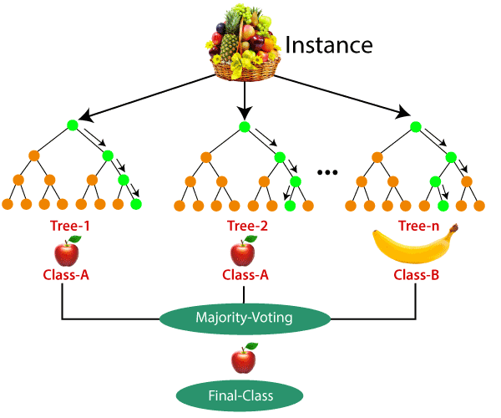
classification
Random Forest Random forest classifier is a meta-estimator that fits a number of decision trees on various sub-samples of datasets and uses average to improve the predictive accuracy of the model and controls over-fitting. The sub-sample size is always the same as the original input sample size but the samples are drawn with replacement.
Reduction in over-fitting and random forest classifier is more accurate than decision trees in most cases.
Introduction
What is classification algorithms?
Why classification is important in machine learning ?
Best machine learning algorithms for classification
Types of classification ML
Use cases of classification algorithms
Logistic Regression
Types of logistic Regression :
Naïve Bayes
K-Nearest Neighbors
Decision Tree
Support Vector Machines
Stochastic gradient descent
Random Forest
The most popular Libraries in machine learning and why we use jupyter notbooks
Conclusion

Slide 19
The most popular Libraries in machine learning and why we use jupyter notebooks
working with machine learning projects: We use an environment called jupyter for writing our code technically we can still use vs code or any other code editors but these editors are not ideal for machine learning b/c we frequently need to inspect the data and that is really hard in environment like vs code editor and terminal.
It is really difficult to inspect 10 or 30 columns of data in terminal or vs code editor but in jupyter we can.
numpy: Which provides multi dimensional array
Pandas: which is data analysis library that provide concept called data frame is a two dimensional structure Such as rows columns.
Matplotlib: Which is two dimensional library used to create or plot graphs
Scikit-learn :Provides all common algorithms like decision tree ,neuron networks so on
Why we use jupyter notebook platform?
numpy
Pandas
Matplotlib
Scikit-learn

Slide 20
conclusion
Classification Algorithms | Accuracy | F1-Score
Logistic Regression | 84.60% | 0.6337
Naïve Bayes | 80.11% | 0.6005
Stochastic Gradient Descent | 82.20% | 0.5780
K-Nearest Neighbours | 83.56% | 0.5924
Decision Tree | 84.23% | 0.6308
Random Forest | 84.33% | 0.6275
Support Vector Machine | 84.09% | 0.6145
Comparison Matrix
Accuracy: (True Positive + True Negative) / Total Population
Accuracy is a ratio of correctly predicted observation to the total observations. Accuracy is the most intuitive performance measure.
True Positive: The number of correct predictions that the occurrence is positive
True Negative: The number of correct predictions that the occurrence is negative
F1-Score: (2 x Precision x Recall) / (Precision + Recall)
F1-Score is the weighted average of Precision and Recall used in all types of classification algorithms. Therefore, this score takes both false positives and false negatives into account. F1-Score is usually more useful than accuracy, especially if you have an uneven class distribution.
Precision: When a positive value is predicted, how often is the prediction correct?
Recall: When the actual value is positive, how often is the prediction correct?

Slide 21
Feature SelectionTechniques in Machine Learning with Python
Feature SelectionTechniques in Machine Learning with Python
Feature Selection is one of the core concepts in machine learning which hugely impacts the performance of your model. The data features that you use to train your machine learning models have a huge influence on the performance you can achieve.
Irrelevant or partially relevant features can negatively impact model performance.
Feature selection and Data cleaning should be the first and most important step of your model designing.
In this post, you will discover feature selection techniques that you can use in Machine Learning.
Feature Selection is the process where you automatically or manually select those features which contribute most to your prediction variable or output in which you are interested in.
Having irrelevant features in your data can decrease the accuracy of the models and make your model learn based on irrelevant features.
How to select features and what are Benefits of performing feature selection before modeling your data?
· Reduces Overfitting: Less redundant data means less opportunity to make decisions based on noise.
· Improves Accuracy: Less misleading data means modeling accuracy improves.
Reduces Training Time: fewer data points reduce algorithm complexity and algorithms train faster.

Slide 22
3 Feature selection techniques that are easy to use and also gives good results.
1. Univariate Selection
2. Feature Importance
3.Correlation Matrix with Heatmap
Feature SelectionTechniques in Machine Learning with Python

Slide 23
Feature SelectionTechniques in Machine Learning with Python
import pandas as pd
import numpy as np
from sklearn.feature_selection import SelectKBest
from sklearn.feature_selection import chi2
data = pd.read_csv("D://Blogs//train.csv")
X = data.iloc[:,0:20] #independent columns
y = data.iloc[:,-1] #target column i.e price range
#apply SelectKBest class to extract top 10 best features
bestfeatures = SelectKBest(score_func=chi2, k=10)
fit = bestfeatures.fit(X,y)
dfscores = pd.DataFrame(fit.scores_)
dfcolumns = pd.DataFrame(X.columns)
#concat two dataframes for better visualization
featureScores = pd.concat([dfcolumns,dfscores],axis=1)
featureScores.columns = ['Specs','Score'] #naming the dataframe columns
print(featureScores.nlargest(10,'Score’))
#print 10 best features
1. Univariate Selection
1. Univariate Selection
Statistical tests can be used to select those features that have the strongest relationship with the output variable.
The scikit-learn library provides the SelectKBest class that can be used with a suite of different statistical tests to select a specific number of features.
The example below uses the chi-squared (chi²) statistical test for non-negative features to select 10 of the best features from the Mobile Price Range Prediction Dataset.

Slide 24
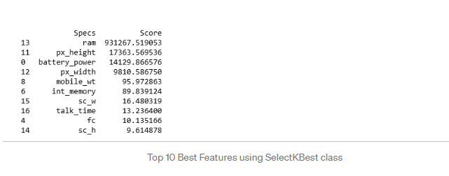

Slide 25
Feature SelectionTechniques in Machine Learning with Python
import pandas as pd
import numpy as np
data = pd.read_csv("D://Blogs//train.csv")
X = data.iloc[:,0:20] #independent columns
y = data.iloc[:,-1] #target column i.e price range
from sklearn.ensemble import ExtraTreesClassifier
import matplotlib.pyplot as plt
model = ExtraTreesClassifier()
model.fit(X,y)
print(model.feature_importances_) #use inbuilt class feature_importances of tree based classifiers
#plot graph of feature importances for better visualization
feat_importances = pd.Series(model.feature_importances_, index=X.columns)
feat_importances.nlargest(10).plot(kind='barh')
plt.show()
2. Feature Importance
You can get the feature importance of each feature of your dataset by using the feature importance property of the model.
Feature importance gives you a score for each feature of your data, the higher the score more important or relevant is the feature towards your output variable.
Feature importance is an inbuilt class that comes with Tree Based Classifiers, we will be using Extra Tree Classifier for extracting the top 10 features for the dataset.

Slide 26
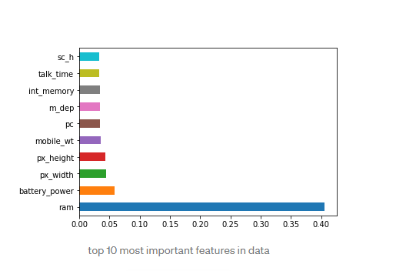

Slide 27
Feature SelectionTechniques in Machine Learning with Python
import pandas as pd
import numpy as np
import seaborn as sns
data = pd.read_csv("D://Blogs//train.csv")
X = data.iloc[:,0:20] #independent columns
y = data.iloc[:,-1] #target column i.e price range
#get correlations of each features in dataset
corrmat = data.corr()
top_corr_features = corrmat.index
plt.figure(figsize=(20,20))
#plot heat map
g=sns.heatmap(data[top_corr_features].corr(),annot=True,cmap="RdYlGn")
Have a look at the last row i.e price range, see how the price range is correlated with other features, ram is the highly correlated with price range followed by battery power, pixel height and width while m_dep, clock_speed and n_cores seems to be least correlated with price_range.
“With the new day comes new strength and new thoughts “— Eleanor Roosevelt
3.Correlation Matrix with Heatmap
Correlation states how the features are related to each other or the target variable.
Correlation can be positive (increase in one value of feature increases the value of the target variable) or negative (increase in one value of feature decreases the value of the target variable)
Heatmap makes it easy to identify which features are most related to the target variable, we will plot heatmap of correlated features using the seaborn library.

Slide 28
